Slide 1

ChordRipple: An Update
Zuyu Chen, Samuel Missner, Yurui Wu
October 23, 2022

Slide 2

Our Tasks From Last Time
Fix problems getting the web app server to not error.
Plan out our evaluation of the system.
Recruit more people for user study and plan how to perform it.

Slide 3
Fixing web app much bigger problem than expected
Initially, we foolishly tried to configure everything from Python2 to Python3, this never ended up working.
Socketio package to connect user to server hadn’t been supported in years, but was too integral to the way that the system works to remove.
We had no documentation for what package versions were being used(We actually found this yesterday in a very unintuitive spot of the repository).
Finally got it to work after figuring out which version of each package was being used manually.

Slide 4
How can we collect user data for evaluation?
Evaluating the web app backend seems to indicate that the evaluation data(User satisfaction and chord prog. novelty) are stored by the system, but we have yet to figure out exactly how to obtain this data.
If need be, the user satisfaction can be obtained manually since we can just ask the participant for the relevant rating in regards to satisfaction(rating out of 5 of their highest rated progression), and we can process the data manually.
Novelty is unlikely to be able to process manually since it requires a comparison with the dataset to calculate.

Slide 5
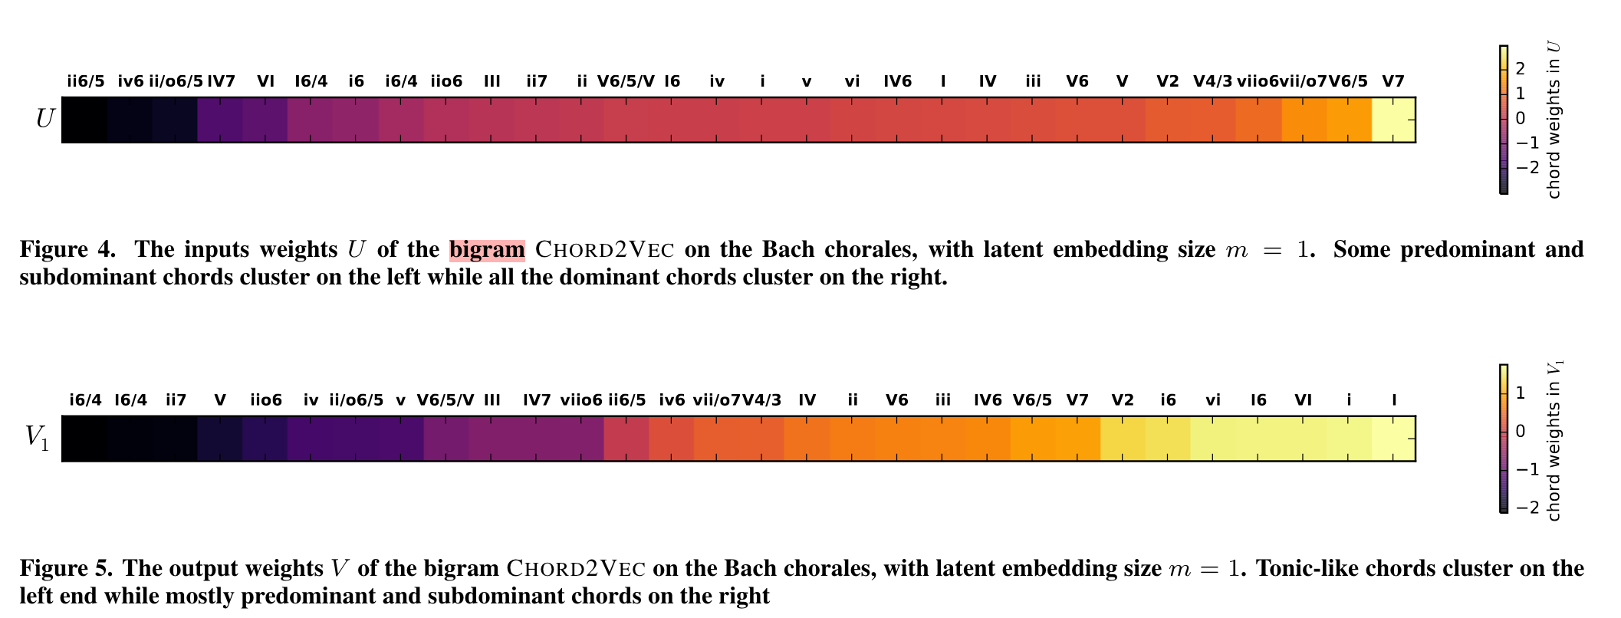
Retrain the Embedding Model ?
Do we have evaluation metrics?
–Bigram plot
But the best embedding model is NOT trained with Bach and not Bigram!
– Though the query for singleton substitution uses bigram model; The embedding model and Ripple adopt skip-gram.
– BTW, the bigram model is included in Skipgram class

Slide 6
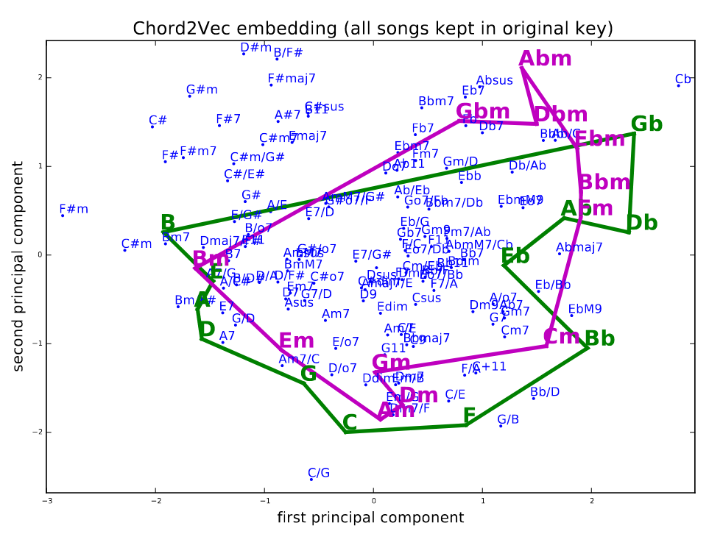
Embedding Visualization
Different Models
The plot – kept in original keys
The model – trained with all transposed to C as we tried with the app
Didn't find the original raw data in the dataset; All transposed
Even if the raw data is available and we use it to train, it still cannot validate the model used for the app

Slide 7
Findings about the code
The system wrapper function that organizes all the subclasses in order of the workflow from data preprocessing, model retrieving, suggestion using dynamic programming is named as resource under the app folder
Took me a lot of time to figure it out the pipeline of the code
Processed by SocketIO
The plots shown in the paper are not of the model to be used for the app. The latter is not plotted but the weights are given.

Slide 8
Experiment 1 – Structured Observations
Three tasks
Interaction with the app and Impact on their compositional process
Composers' goal and expectations vary and could contrast
Depending on their expectation and goals, the app can
support their intentions by recommending next chord
or alter their intentions by using the Ripples to change what is fixed

Slide 9
What is the web app’s function
Designed of Experiment 2
Includes a tutorial page and three experiment page with random order
Provides a picture and a related 8-chord long progression
Recommendations for the current active chord
Ratings

Slide 10
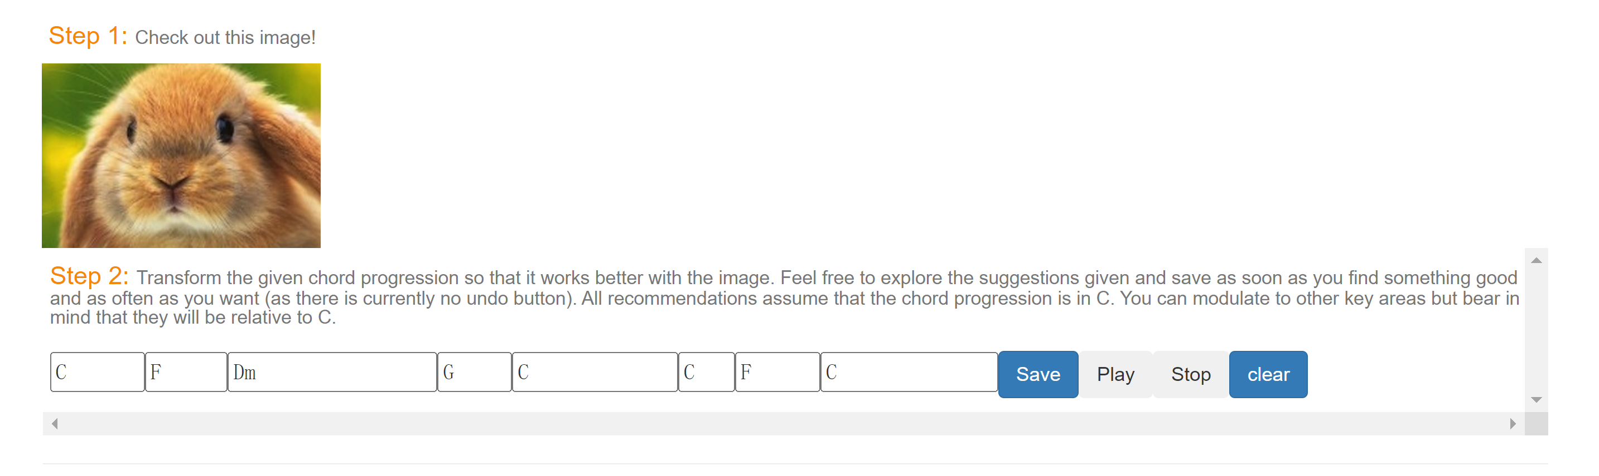
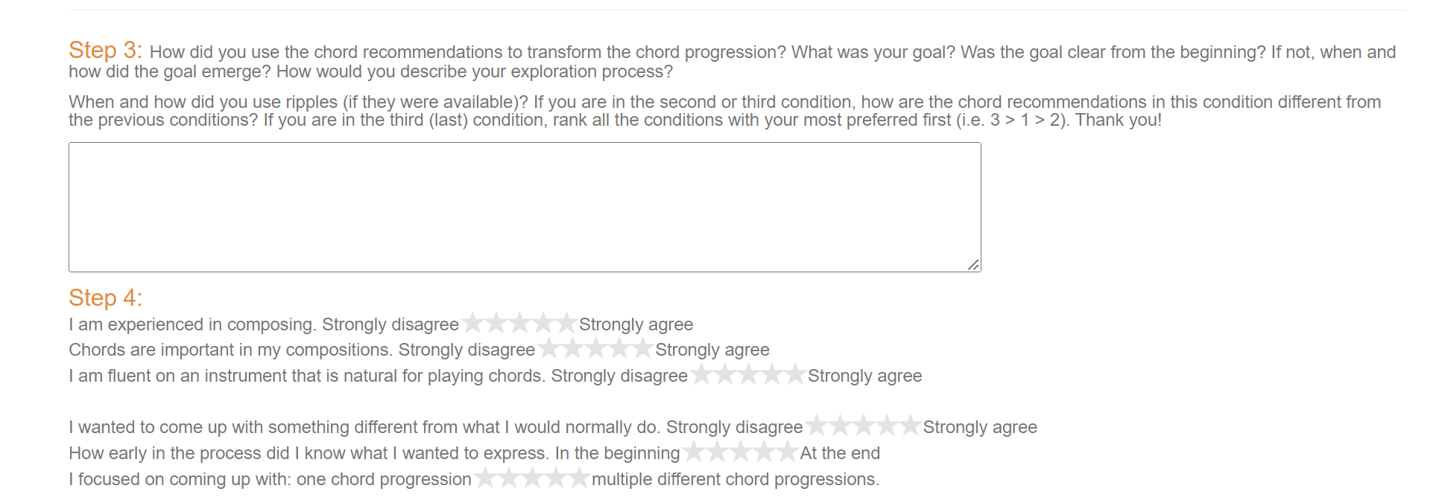
What is the web app’s function

Slide 11
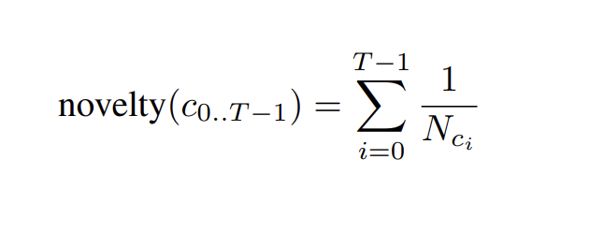
Experiment 2
Controlled experiment
Independent variable: recommendation types
Singleton-typical
Singleton-adventurous
Ripple
Dependent variable:
novelty of chord progression
user’s level of satisfaction
Analysis:
Use nonparametric Friedman test to check if there are differences among levels
perform the planned pairwise comparisons following the hypotheses
use the nonparametric Wilcoxon signed-rank test to see if the results are statistically significant

